Slide 1
ITA17 Natural Language Processing with Deep Learning
Lec.1-6: Yuichi Yaguchi (Legacy NLP)
Lec. 7-13: Incheon Paik (NLP on DL)
Lec. 14 & Exam: You! (Project Presentation)

Slide 2
Plan for Lec. 1 – Lec. 6
Lec.1 (10/6) Introduction to NLP and NLTK Pipeline
NLP definition & tasks, history & paradigm shifts, classical / brain / neural pipelines, fundamental features (BoW, TF-IDF, LSA) NLTK processing flow
Lec.2 (10/8) Hands-on: NLTK Pipeline (Self-study)
Google Colab setup, corpus loading (Bible), tokenization & POS tagging, frequency & TF-IDF analysis, text search & simple classification
Lec.3 (10/15) Statistical Models for Language
n-gram language model, Markov assumption, smoothing & back-off, Hidden Markov Model (POS tagging), Naïve Bayes text classification
Lec.4 (10/20) Recurrent Neural Networks and LSTM
RNN architecture, sequence modeling, vanishing/exploding gradients, LSTM/GRU gates & long-term memory, text generation & classification
Lec.5 (10/22) Deep Models and Classical NLP
TF-IDF & LSA vs embeddings, probabilistic vs neural sequence models, feature design & dimensionality reduction, integration of NLTK and RNN/LSTM
Lec.6 (10/27) Hands-on: RNN/LSTM for Q&A
PyTorch environment, text embedding preparation, RNN/LSTM training on Bible corpus, question–answer retrieval, performance evaluation

Slide 3
Introduction: Human Languages
You know ~50,000 words of primary language, each with several meanings
Six years old knows ~13000 words
First 16 years we learn 1 word every 90 min of waking time
Mental grammar generates sentences -virtually every sentence is novel
3 years old already have 90% of grammar
~6000 human languages – none of them simple!
Adapted from Martin Nowak 2000 – Evolutionary biology of language – Phil.Trans. Royal Society London
Notes:
あなたは〜50,000語の第一言語を知っていて、それぞれにはいくつかの意味があります
6歳は〜13000語を知っています
最初の16年間、目覚める時間90分ごとに1単語を学習します
精神文法は文を生成する - 事実上すべての文は新規である
3歳の方はすでに90％の文法を持っています
〜6000人の人間の言語 - それらのどれもシンプルではありません！

Slide 4
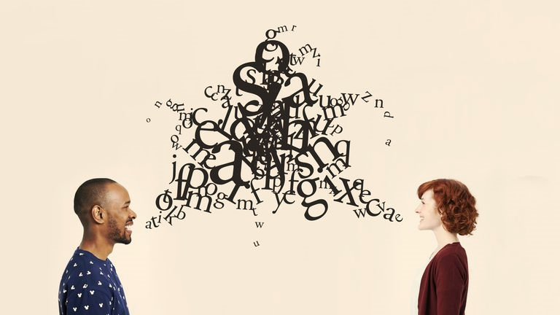
Definition of Natural Language
A natural language is a human language, such as English or Standard Mandarin, as opposed to a constructed language, an artificial language, a machine language, or the language of formal logic. Also called ordinary language.
Computer language and artificial language are different
Esperanto = grammar, phonology artificially created. Characters use alphabetic letter system (created by Ludovico Zamenhoff and disciples)
These artificial languages ​​are a framework of "natural language" (differences between spontaneous and artificial)
A computer language is the language compiled in a form that human beings can easily understand so that it can be converted into "a binary expression that can be understood by a computer

Slide 5

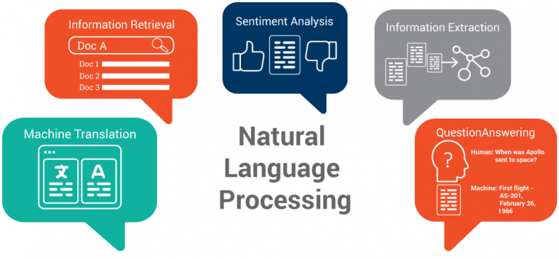


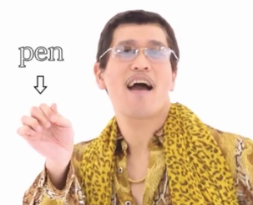
What is Natural Language Processing
Human Language
Applications
Processing
Acquisition
Data Store
a, ɪ, h, æ, v, ə, p, ɛ, n
I ha ve a pe n
I have a pen

Slide 6
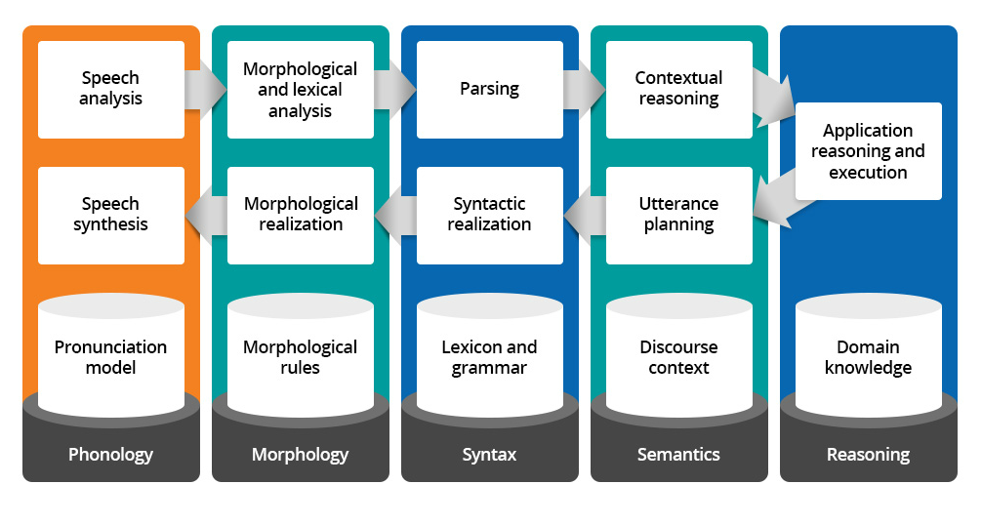
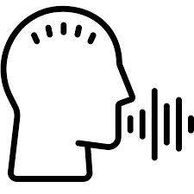
Scheme of Language Study
Pragmatics
音韻論
形態論
統語論
意味論
推論/語用論
Phonetics

Slide 7

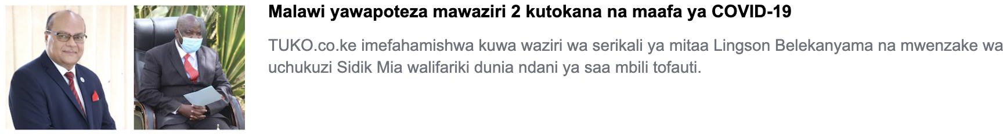
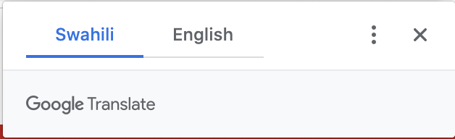
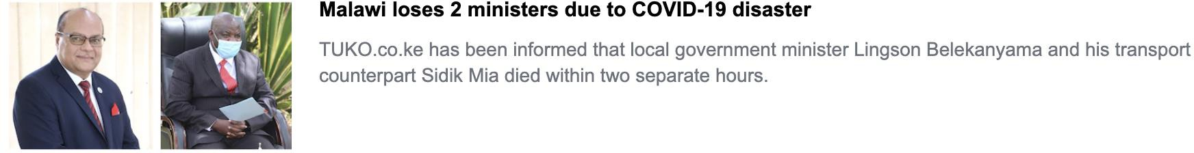
Current NLP Apps: Neural Machine Translateion
https://kiswahili.tuko.co.ke/
cs224n-2025-lecture01-wordvecs1.pdf

Slide 8
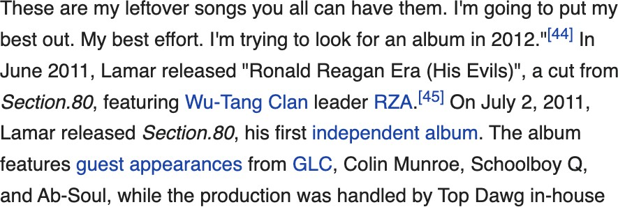
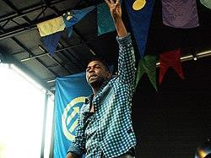
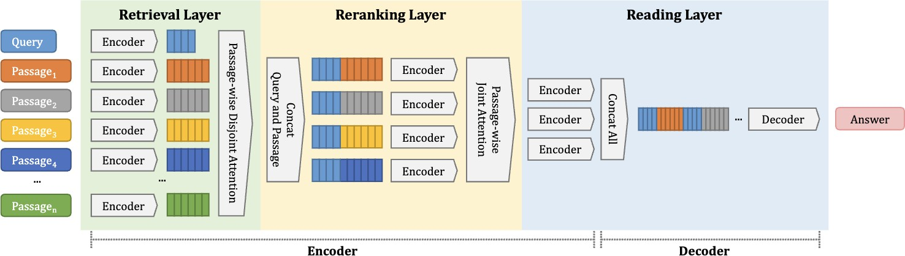
Current NLP Apps: Next gen search
when did Kendrick lamar’s
first album come out?
July 2, 2011
E.g., YONO (Lee et al. 2021) uses a T5 model fine-tuned for QA
cs224n-2025-lecture01-wordvecs1.pdf

Slide 9

Current NLP Apps: GPT-3 – and more
cs224n-2025-lecture01-wordvecs1.pdf
The SEC said, “Musk, your tweets are a
blight.
They really could cost you your job,
if you don't stop all this tweeting at night.”
Then Musk cried, “Why?
The tweets I wrote are not mean,
I don't use all-caps
and I'm sure that my tweets are clean.”
“But your tweets can move markets
and that's why we're sore.
You may be a genius and a billionaire, but it doesn't give you the right to
be a bore!”
S: I broke the window. Q: What did I break?
S: I gracefully saved the day. Q: What did I gracefully save? S: I gave John flowers.
Q: Who did I give flowers to?
S: I gave her a rose and a guitar.
Q: Who did I give a rose and a guitar to?
How many users have signed up since the start of 2020?
SELECT count(id) FROM users WHERE created_at > ‘2020-01-01’
What is the average number of influencers each user is subscribed to?
SELECT avg(count) FROM ( SELECT user_id, count(*) FROM subscribers GROUP BY user_id )
AS avg_subscriptions_per_user

Slide 10
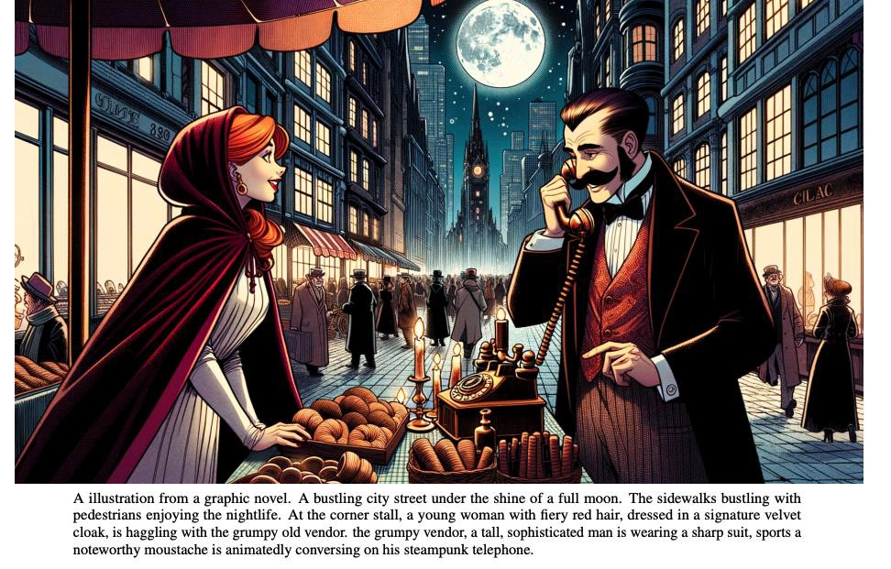
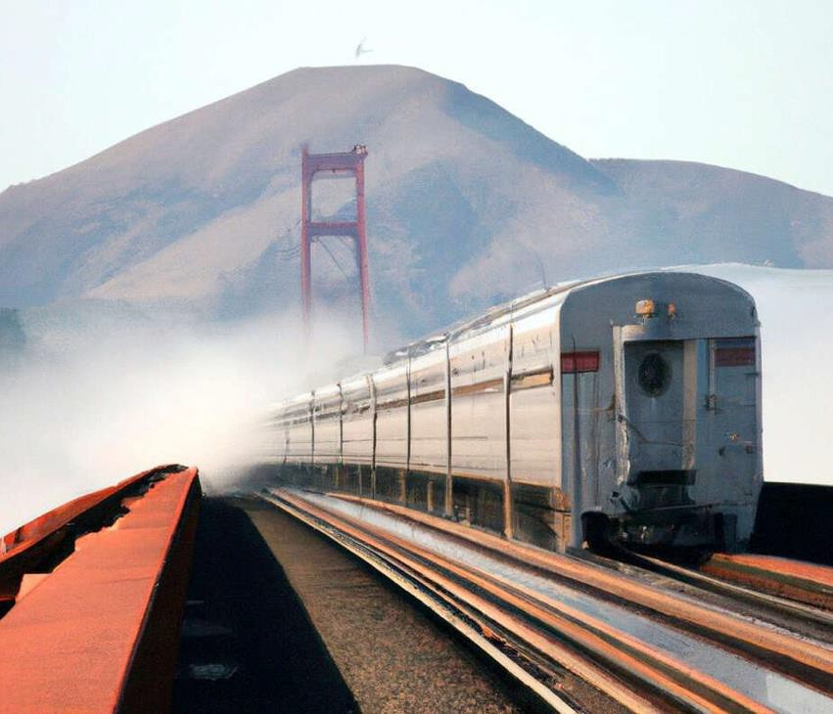
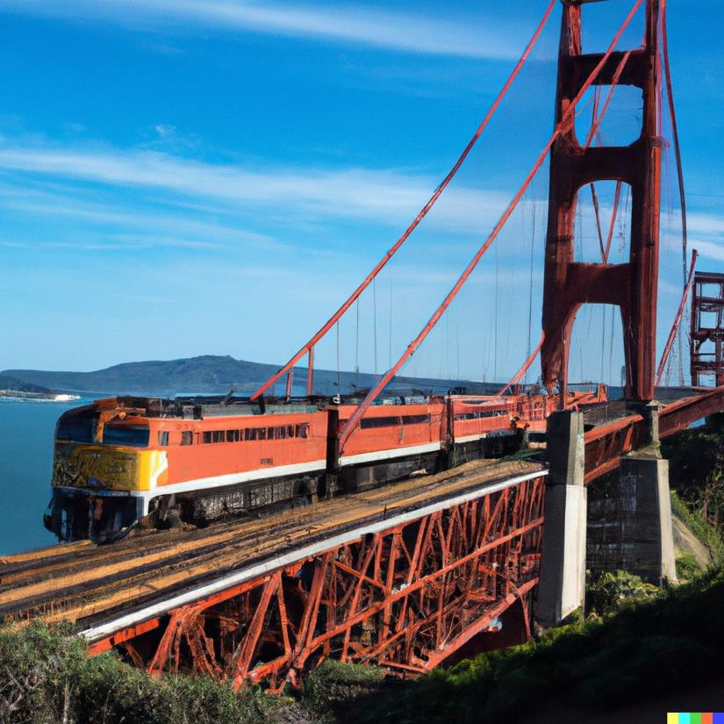
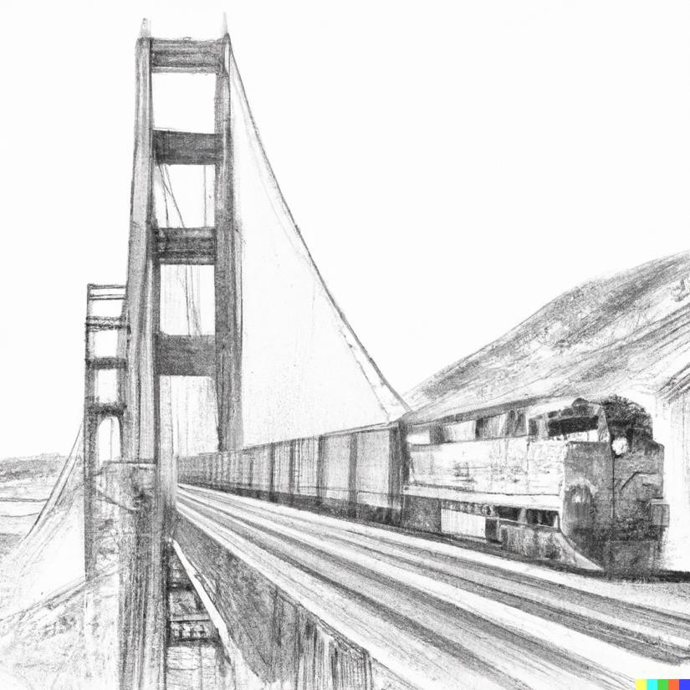
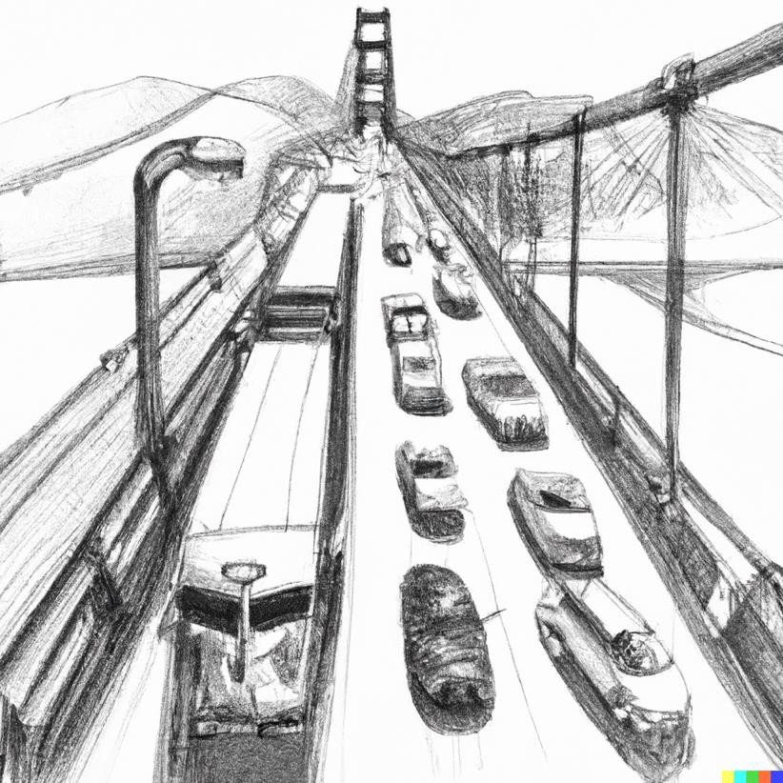
a train going over the Golden Gate bridge
a train going over the Golden Gate bridge with the bay in the background
a train going over the Golden Gate bridge detailed pencil drawing
cars and a train on the Golden Gate bridge detailed pencil drawing
Pictures by
OpenAI’s DALL-E 2

Slide 11
Why Language is…
Hard!
NLP is AI-complete
Abstract concepts are difficult to represent
LOTS of possible relationships among concepts
Many ways to represent similar concepts
Tens of hundreds or thousands of features/dimensions
Easy!
Highly redundant
Many relatively crude methods provide fairly good results
Notes:
NLPはAI完成です
抽象的な概念は表現するのが難しい
概念間の可能な関係の可能性
類似の概念を表現する多くの方法
何十、何千もの機能/寸法

Slide 12
Objective of Natural Language Processing
Fundamental goal: deep understand of broad language
Not just string processing or keyword matching!
Understanding: Interpreting what a text or utterance means.
Generation: Producing natural sentences from a given meaning or condition.
Interaction: Enabling natural communication between humans and computers.
Typical NLP Pipeline
Input acquisition
Speech (converted to text via ASR), Raw text
Preprocessing
Noise removal, normalization, Tokenization, morphological analysis, Stopword removal, stemming / lemmatization
Feature extraction
Bag-of-Words, TF-IDF, Word Embeddings, Contextual vectors (e.g., BERT)
Syntactic & semantic analysis
POS tagging, dependency/constituency parsing, Named Entity Recognition (NER), Semantic Role Labeling (SRL)
Task-specific processing
Classification (sentiment, spam detection), Generation (summarization, translation, dialogue),Reasoning (question answering, knowledge inference)
Output generation
Human-readable text, Task results (categories, scores, summaries, etc.)
Notes:
基本的な目標：広範な言語の深い理解
文字列処理やキーワードマッチングだけでなく、
ビルドしたいエンドシステム：
野心的：音声認識、機械翻訳、質問応答...
Modest：スペルの修正、テキストの分類...

Slide 13
History of NLP
Prehistory (1940s–1960s)
Foundations of Computation & Language: Turing (1936) computability; Turing Test (1950); Shannon (1948) Information Theory; McCulloch & Pitts (1943) artificial neuron
Formal Language Theory: Chomsky (1957) Syntactic Structures; Chomsky hierarchy; generative grammar
Machine Translation (MT) Origins: Weaver memo (1949); Georgetown–IBM experiment (1954) early MT optimism
Early Corpora: Brown Corpus (1961–64) enabling statistical experiments
Early Speech Work: Bell Labs Audrey (1952), IBM Shoebox (1962) — digit/limited-vocabulary recognition
Setbacks: ALPAC report (1966) criticized MT for “no real understanding,” leading to funding cuts
Notes:
Slide 1 — 前史 (1940s–1960s)
計算と言語の基盤：Turing (1936) 計算可能性／Turing Test (1950)；Shannon (1948) 情報理論；McCulloch–Pitts (1943) 人工ニューロン
形式言語：Chomsky (1957) Syntactic Structures／チョムスキー階層・生成文法
機械翻訳の萌芽：Weaver (1949) メモ；Georgetown–IBM実験 (1954) → MT楽観
コーパスの始まり：Brown Corpus(1961–64) → 言語統計の実験土壌
音声の初期成果：Bell Labs Audrey(1952), IBM Shoebox(1962)（数字/小語彙認識）
挫折と再考：ALPAC報告(1966) → MT研究費削減／「深い理解の不在」問題化

Slide 14
History of NLP
Early Work (1960s–1970s) – Symbolic Era
Rule-based NLP: Hand-written grammars & parsers (e.g., ATN Woods 1970; Earley/CYK algorithms)
Semantics & Knowledge: Fillmore Case Grammar (1968); Minsky Frames (1974)
Dialogue/Understanding Demos: ELIZA (Weizenbaum 1966) pattern matching; SHRDLU (Winograd 1970–72) block world
Logic & Programming: Prolog (Colmerauer 1972); LUNAR QA (Woods 1973); Pereira & Warren DCG (conceptual seeds in late 1970s)
Probabilistic Seeds: Mosteller & Wallace (1964) Bayesian authorship; early HMM theory (Baum 1960s)
Funding & Critiques: DARPA Speech Understanding Research (1971–); Lighthill report (1973) dampened over-optimism
Notes:
Slide 2 — 草創期 (1960s–1970s) 記号主義と初期NLP
記号的NLP：手書き文法・構文解析（ATN: Woods 1970；Earley(1970), CYK）
意味論と知識表現：Fillmore Case Grammar(1968)；Minsky Frames(1974)
対話/理解デモ：ELIZA(Weizenbaum 1966) パターン照合；SHRDLU(Winograd 1970–72) ブロック世界
論理とプログラミング：Prolog(Colmerauer 1972)；LUNAR(Woods 1973)；Pereira & Warren DCG(1980, 発端は70s)
確率/統計の萌芽：Mosteller & Wallace (1964) ベイズ著者識別；初期HMM理論（Baum 1960s）
資金と批判：DARPA Speech Understanding Research(1971–)／Lighthill報告(1973) で過剰期待を反省

Slide 15
History of NLP
“Middle Ages” / Transition (1970s–1990s)
HMM Breakthroughs: Applied to speech by Baker/Dragon, IBM Jelinek; Tangora (1980s) large-vocabulary ASR; CMU Harpy/Sphinx
Formal Semantics: Montague Grammar (1970) — rigorous compositional semantics
Discourse & Dialogue: Grosz & Sidner (1986) discourse structure; Mann & Thompson (1988) RST; Grice (1975) conversational implicature
Knowledge & Story Understanding: Schank Conceptual Dependency (1969); Scripts (1977); systems MARGIE/SAM
Resources & Evaluation: Penn Treebank (Marcus 1993); WordNet (Miller 1995); MUC (IE) & TREC (QA) shared tasks
Paradigm Shift: From rule-based systems to data-driven statistics
Notes:
Slide 3 — 「中世」〜転換期 (1970s–1990s) 統計化への橋渡し
HMMの確立とASR：Baker/Dragon；IBM Jelinek；Tangora(1980s) 大語彙連続音声；CMU Harpy/Sphinx
形式意味論：Montague Grammar(1970)（作曲的意味論の厳密化）
談話・対話：Grosz & Sidner (1986) 談話構造；Mann & Thompson (1988) RST；Grice (1975) 含意
知識/ストーリ理解：Schank Conceptual Dependency(1969)／Scripts(1977)；MARGIE/SAM
資源と評価：Penn Treebank(Marcus 1993)；WordNet(Miller 1995)；MUC（情報抽出）・TREC（QA）
流れの変化：ルール→データ駆動へのシフトが本格化（統計解析・学習器の台頭）

Slide 16
History of NLP
Statistical Revolution (1990s–2000s)
Data + Compute = Machine Learning NLP
n-gram Language Models: Katz back-off; Kneser–Ney smoothing — standard for ASR, input methods, spelling correction
Sequence Labeling: HMM POS/NER; Brill Tagger (1992); MEMM (McCallum 2000); CRF (Lafferty 2001)
Classification & Parsing: MaxEnt (Berger 1996); SVM text classification (Joachims 1998); Collins/Charniak statistical parsers
Machine Translation: IBM statistical MT (Brown et al. 1993); BLEU metric (Papineni 2002); Google SMT deployment (2006)
Industrial Products: Dragon NaturallySpeaking (1997) speech dictation; large-scale spam filters; web search query understanding
Notes:
Slide 4 — 統計的革命 (1990s–2000s) 機械学習NLPの確立
コーパス×計算資源：大規模テキスト＋計算力でデータ駆動が主流に
n-gram言語モデル：Katz back-off／Kneser–Ney平滑化 → ASR/IME/補完の標準
系列ラベリング：HMM POS/NER；Brill Tagger(1992)；MEMM(McCallum 2000)；CRF(Lafferty 2001)
分類と解析：MaxEnt(Berger 1996)；SVM文書分類 (Joachims 1998)；Collins/Charniak 統計的構文解析
機械翻訳：IBM 統計的MT（Brown et al. 1993）→ BLEU(Papineni 2002)で評価確立；Google SMT運用(2006〜)
応用/製品：Dragon NaturallySpeaking(1997) 音声入力；スパムフィルタ／Web検索クエリ理解の実用化

Slide 17
History of NLP
Distributed Representations & Neural Era (2010s–present*)
Word Embeddings: Word2Vec (Mikolov 2013); GloVe (2014); fastText (2017); Doc2Vec (2014)
Neural Language Models: Bengio et al. (2003) → Mikolov (2010) RNNLM for practical use
Sequence Models: LSTM (Hochreiter & Schmidhuber 1997, widely adopted in 2010s); GRU (Cho 2014)
Encoder–Decoder Framework: Seq2Seq (Sutskever 2014) for MT and summarization
Bahdanau Attention (2015) — mitigates information bottlenecks (skip if limiting to pre-Transformer)
Real-world Systems: Google Neural MT (2016); voice assistants (Siri, Alexa, Cortana); IBM Watson (Jeopardy! 2011)
Open Challenges: scaling & energy use, bias/fairness (Caliskan 2017), interpretability and sustainability
Notes:
Slide 5 — 分散表現とニューラル (2010s– ) ※本講はTransformer前まで
単語埋め込み：Word2Vec(Mikolov 2013)／GloVe(2014)／fastText(2017)；Doc2Vec(2014)
ニューラルLM：Bengio (2003)→Mikolov (2010) RNNLMで実用域に
系列モデル：LSTM(Hochreiter & Schmidhuber 1997) 再評価／GRU(Cho 2014)；長距離依存の改善
エンコーダ–デコーダ：Seq2Seq(Sutskever 2014) で翻訳/要約の枠組み確立
（必要なら）アテンション導入：Bahdanau(2015) — 長文での情報ボトルネック解消（※Transformerは別講義）
プロダクト/応用：Google NMT(2016) 運用開始；Siri/Alexa/Cortana(2011–) 音声対話；IBM Watson(2011) Jeopardy!
論点：性能とスケール／バイアス(Caliskan 2017)／説明性と持続可能性

Slide 18
NLP Pipeline
Cognitive / Neuroscience-inspired Understanding Pipeline
Foundation
Human language comprehension mechanisms (sensory input → neural processing)
Approach
Psycholinguistics, neurolinguistics
Flow (conceptual model)
Sensory input (auditory waveforms / visual information)
Phonological & morphological processing (phoneme recognition, morpheme segmentation)
Syntactic processing (incrementally building sentence structure)
Semantic integration (matching with mental lexicon and knowledge networks)
Situation model construction (integrating discourse with context and experience)
Characteristics
Mixture of parallel and sequential processing
Extralinguistic cues (gesture, environment) contribute to comprehension
Continuous prediction and completion during understanding

Slide 19
NLP Pipeline
Classical Linguistics–based NLP Pipeline
Foundation
Formal language theory, grammar rules, formal semantics
Approach
Rule-based processing, syntactic parsing, symbolic reasoning
Flow (example: sentence meaning)
Morphological analysis (split into morphemes, POS tagging)
Syntactic parsing (build parse trees based on grammar)
Semantic analysis (word sense disambiguation, semantic role labeling)
Discourse analysis & inference (context and world knowledge)
Characteristics
High transparency and explainability at each step
Hard to handle domain transfer and polysemy
Costly to build and maintain large rule sets or knowledge bases

Slide 20
NLP Pipeline
Deep Learning (DNN)-based Understanding Pipeline
Foundation
Large-scale data–driven statistical learning
Approach
End-to-end learning where feature extraction and semantic mapping are jointly optimized
Flow (Transformer-type example)
Input representation (token/ subword IDs, embeddings)
Contextualization (self-attention computes relationships among all tokens)
High-level feature extraction (multi-layer Transformer captures semantic and relational patterns)
Task-specific output (classification, generation, inference)
Characteristics
Feature extraction and semantic integration learned together in a largely black-box fashion
Strong generalization from massive pretraining
Lower interpretability; internal representations often hard to explain

Slide 21
NLTK Pipeline: From Language Structure to Features
Language structure:
grammar (syntax rules) and words (morphology)
Example: English uses word order (SVO); Japanese uses case particles.
Writing systems:
phonetic (alphabetic, syllabic) vs. ideographic (kanji, Chinese characters)
Example: English vs. Chinese tokenization differences.
Word boundaries & tokenization:
explicit spaces vs. no spaces (e.g., Chinese, Japanese)
Morphology:
stems, prefixes/suffixes, derivation
Example: un- + happy → unhappy
Lexical semantics:
sense disambiguation, synonyms/antonyms, idioms
Example: bank (riverbank vs. financial)
Feature representations:
Bag-of-Words, TF-IDF, LSA
NLTK tools:
word_tokenize, pos_tag, WordNet, stopwords, FreqDist, TfidfVectorizer (scikit-learn)

Slide 22
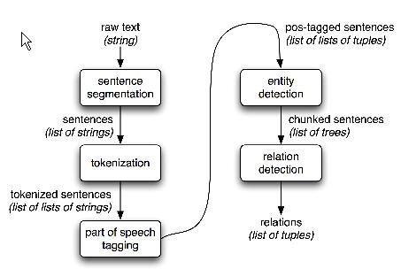
NLTK Pipeline (E.g. Information Extraction)

Slide 23
NLTK Pipeline: Grammar and Words
Grammar vs. Words
Syntax defines legal word order: e.g., The dog chased the cat (SVO)
Morphology defines word formation: plural -s, past tense -ed
Writing system impact
Alphabetic (English): tokenization straightforward
Logographic (Chinese): need statistical or dictionary-based segmentation
Practical NLP impact
Different tokenization and POS strategies by language
NLTK demo
Simple grammar parsing:
POS tagging: nltk.pos_tag(tokens)
grammar = nltk.CFG.fromstring("S -> NP VP ...")
parser = nltk.ChartParser(grammar)

Slide 24
NLTK Pipeline: Tokenization and Morphology
Tokenization
Split text into words, handle punctuation and clitics
Example: "Mr. O'Neill can't attend." → ["Mr.", "O'Neill", "ca", "n't", "attend", "."]
Morphological Analysis
Stemming: heuristic root (running → runn)
Lemmatization: dictionary root (running → run)
Prefix/suffix detection: re-, -ness
NLTK tools
nltk.word_tokenize, RegexpTokenizer
nltk.PorterStemmer(), nltk.WordNetLemmatizer()

Slide 25
NLTK Pipeline: POS Tagging and Stopwords
Part-of-Speech (POS) Tagging
Assign syntactic roles: noun (NN), verb (VB), adjective (JJ)
Example: “Time flies like an arrow.” → [NN VB IN DT NN]
Stopwords
Common words with little discriminative value: the, is, of
Removing them improves BoW/TF-IDF performance
NLTK tools
nltk.pos_tag(tokens)
nltk.corpus.stopwords.words('english')
Frequency analysis: nltk.FreqDist(tokens)

Slide 26
NLTK Pipeline: Lexical Semantics
Word Sense Disambiguation (WSD)
Determine correct sense of polysemous words
Example: bank (financial vs. river bank)
nltk.wsd.lesk(sentence, word)
Synonyms & Antonyms
Group related meanings for richer features
Example: WordNet synsets for good (synonyms: fine, excellent; antonyms: bad)
Idioms & Multi-word Expressions
Fixed phrases with non-literal meaning
Example: “kick the bucket” = die
NLTK tools
nltk.corpus.wordnet.synsets(), semantic similarity functions

Slide 27
NLTK Pipeline: From Features to Vector Representations
Bag-of-Words (BoW)
Count word frequencies; ignores order
Example: {"dog":2, "bark":1}
TF-IDF
Downweights frequent words, highlights discriminative terms
Example: “rareword” gets higher weight than “the”
Latent Semantic Analysis (LSA)
SVD-based dimensionality reduction; reveals hidden topics
Implementation
NLTK frequency tools + scikit-learn TfidfVectorizer, TruncatedSVD

Slide 28
Definition of “Word”
a single unit of language that has meaning and can be spoken or written:
Your essay should be no more than two thousand words long.
Some words are more difficult to spell than others.
What's the word for bikini in French?
It's sometimes difficult to find exactly the right word to express what you want to say.
Some words have individual “Semantical” information (lexical words)
Word has “Word Class” = Part of Speech
one of the grammatical groups, such as noun, verb, and adjective, into which words are divided depending on their use:
Notes:
意味を持ち、話したり書いたりすることができる言語の単一単位。
エッセイの長さは2,000ワード以下とする。
スペルが難しい単語があります。
フランス語でビキニは何と言いますか？
言いたいことを表現するのにぴったりな言葉を見つけるのが難しいこともあります。
単語には、個々の「意味的」情報（語彙的単語）があります。
単語には「単語クラス」＝品詞がある
名詞、動詞、形容詞などの文法的なグループの一つで、単語はその用途によって分けられます。

Slide 29
Lexical semantics
Cause
Antonym
kill - die
die – live
die (dice)
Homonym
How words are related with each other
Entailment
Homophone
{conveyance;transport}
pay - buy
buy – by – bye
Hypernym
{vehicle}
Meronym
{car mirror}
{armrest}
{motor vehicle; automotive vehicle}
{car door}
{doorlock}
Synonym
{car; auto; automobile; machine; motorcar}
{bumper}
{hinge;
flexible joint}
{car window}
Hyponym
{cruiser; squad car; patrol car;
police car; prowl car}
{cab; taxi; hack; taxicab}
Notes:
どのように言葉が互いに関連しているか
Hyponymy
緋色、朱色、カルミン、紅色はすべて赤色の下位句です
ハイパーニミー
異端（反対）
男女
メロノミー（一部）
タイヤは車のメロミムです
等..

Slide 30
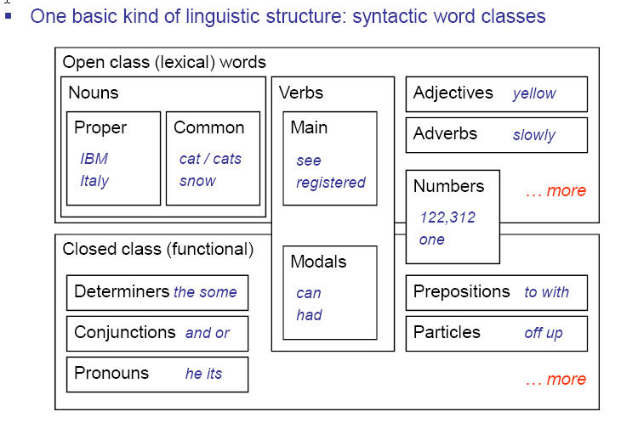
Part-of-speech (English)
From Dan Klein’s cs 288 slides

Slide 31
Morphology
Morphology is the study of the internal structure of words, of the way words are built up from smaller meaning units.
Morpheme:
The smallest meaningful unit in the grammar of a language.
Two classes of morphemes
Stems: “main” morpheme of the word, supplying the main meaning (i.e. establish in the example below)
Affixes: add additional meaning
Prefixes: Antidisestablishmentarianism
Suffixes: Antidisestablishmentarianism
Infixes: hingi (borrow) – humingi (borrower) in Tagalog
Circumfixes: sagen (say) – gesagt (said) in German
Notes:
形態学は単語の内部構造の研究であり、言葉はより小さい意味単位から構築される。
形態素：
言語の文法の中で最も意味のある単位。
2つのクラスの形態素
茎：単語の「主な」形態素、主な意味を提供する（すなわち、以下の例において確立する）
接尾辞：意味を追加する
接頭辞：反捕鯨者主義
サフィックス：反捕鯨者主義
インフィクス：ヒンディー語（借用） - タガログ語でのhumingi（借り手）
Circumfixes：sagen（say） - gesagt（said）ドイツ語で

Slide 32
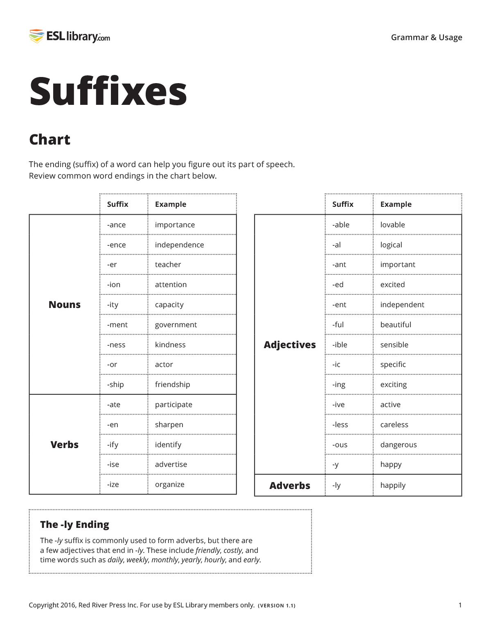
Affect to POS by suffix
When you combine word endings with sentence patterns, the English language makes sense in a whole new way.
Students can guess at a word’s function, and therefore sentence position, even if they don’t yet know the meaning of the word.
[Opposite] For the semantics, we need reduce suffixes if you want to grab that word meaning.
Notes:
語尾と文型を組み合わせると、英語は全く新しい方法で意味を成す。
生徒は、まだ単語の意味を知らなくても、その単語の機能、つまり文の位置が推測できるようになります。
[反対】 意味論としては、その語義をつかむなら接尾辞を減らす必要がある。

Slide 33

Word Senses
Words have multiple distinct meanings, or senses:
Plant: living plant, manufacturing plant, …
Title: name of a work, ownership document, form of address, material at the start of a film, …
Many levels of sense distinctions
Homonymy: totally unrelated meanings (river bank, money bank)
Polysemy: related meanings (star in sky, star on tv, star as a title)
Systematic polysemy: productive meaning extensions (metonymy such as organizations to their buildings) or metaphor
Sense distinctions can be extremely subtle (or not)
Granularity of senses needed depends a lot on the task
Taken from Dan Klein’s cs 288 slides
Notes:
言葉には複数の異なる意味や感覚があります。
植物：生きた植物、製造工場、...
タイトル：作品の名前、所有権の文書、住所の形式、映画の開始時の素材、...
多くのレベルの感覚の区別
同音異義語：まったく無関係な意味（川岸、お金の銀行）
多義性：関連する意味（空の星、テレビの星、タイトル）
体系的な多義性：生産的な意味の拡張（組織への組織のようなmetonymy）またはメタファー
センスの区別は非常に微妙（またはそうではない）
必要な感覚の細分性はタスクに大きく依存する

Slide 34

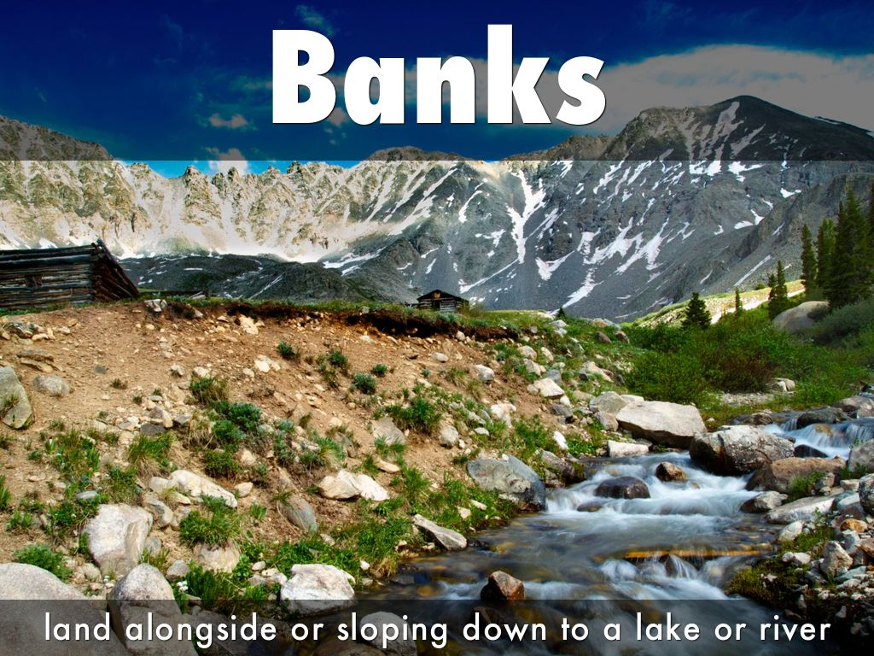
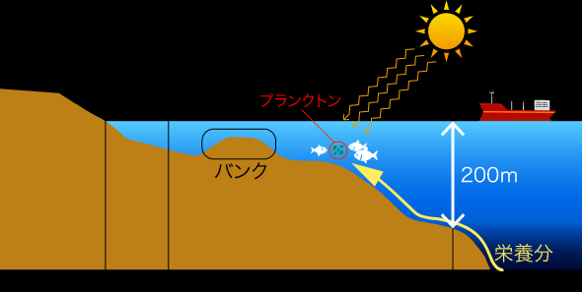
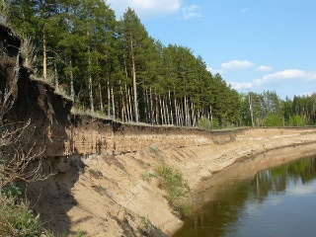
Word Sense Disambiguation
Determine which of the senses of an ambiguous word is invoked in a particular use of the word
Example: living plant vs. manufacturing plant
How do we tell these senses apart?
“Context”
The manufacturing plant which had previously sustained the town’s economy shut down after an extended labor strike.
Maybe it’s just text categorization
Each word sense represents a topic
Why is it important to model and disambiguate word senses?
Translation
Bank → 銀行 or 岸 or 崖
Parsing
For PP attachment, for example
information retrieval
To return documents with the right sense of bank
Adapted from Dan Klein’s cs 288 slides
Notes:
あいまいな言葉のどの感覚が、その言葉の特定の使用において呼び出されるかを決定する
例：生存植物対製造工場
これらの感覚をどうやって区別するのでしょうか？
"コンテキスト"
以前は町の経済を持続させていた製造工場は、労働派遣を延長した後に閉鎖した。
たぶんそれは単なるテキストの分類です
各単語の意味はトピックを表します
言葉の感覚をモデル化して曖昧さを解消することが重要なのはなぜですか？
翻訳
銀行→銀行または岸または崖
解析
PPの取り付けの場合、たとえば
情報検索
銀行の正しい感覚で文書を返す

Slide 35
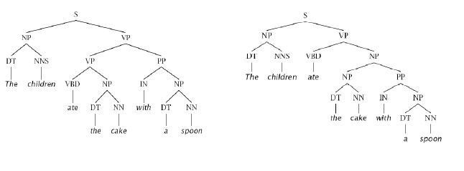
Phrase structure parsing & ambiguity
The children ate the cake with a spoon
PP Attachment Ambiguity
Why is it important for NLP?
Notes:
子供たちはスプーンでケーキを食べた
PP添付ファイルのあいまいさ
なぜNLPにとって重要なのですか？
子供がスプーンでケーキを食べた
子供がスプーン付きのケーキを食べた

Slide 36
Corpus-based statistical approaches to tackle NLP problem
How can a machine understand these differences?
Decorate the cake with the frosting
Decorate the cake with the kids
Rules based approaches, i.e. hand coded syntactic constraints and preference rules:
The verb decorate require an animate being as agent
The object cake is formed by any of the following, inanimate entities (cream, dough, frosting…..)
Such approaches have been showed to be time consuming to build, do not scale up well and are very brittle to new, unusual, metaphorical use of language
To swallow requires an animate being as agent/subject and a physical object as object
I swallowed his story (understand)
The supernova swallowed the planet (take in)
Notes:
この違いを機械はどのように理解するのでしょうか。
フロスティングでケーキを飾る
子供たちと一緒にケーキをデコレーションする
ルールベースのアプローチ、つまり、手書きの構文制約やプリファレンスルールを用いたアプローチ。
動詞decorateはエージェントとして生物を必要とする
オブジェクトであるケーキは、次のいずれかの無生物エンティティによって形成される（クリーム、生地、フロスティング.....）。
このようなアプローチは、構築に時間がかかり、拡張性に乏しく、新しい、珍しい、比喩的な言語の使用に対して非常に脆いことがわかっています。
飲み込むためには、エージェント／サブジェクトとしての生物と、オブジェクトとしての物理的な物体が必要です。
私は彼の話を飲み込んだ(理解した)
超新星が惑星を飲み込んだ(take in)

Slide 37
Corpus-based statistical approaches to tackle NLP problem
A Statistical NLP approach seeks to solve these problems by automatically learning lexical and structural preferences from text collections (corpora)
Statistical models are robust, generalize well and behave gracefully in the presence of errors and new data.
So:
Get large text collections
Compute statistics over those collections
(The bigger the collections, the better the statistics)
Notes:
統計的NLPアプローチは、テキストコレクション（コーパス）から語彙や構造の好みを自動的に学習することで、これらの問題を解決しようとするものです。
統計的モデルはロバストであり、一般化しやすく、エラーや新しいデータがあっても優雅に振る舞うことができます。
そこで
大規模なテキストコレクションを入手
それらのコレクションの統計量を計算する
(集めたテキストが大きければ大きいほど、良い統計がとれる）

Slide 38
Corpus-based statistical approaches to tackle NLP problem
Feature extractions (usually linguistics motivated)
Statistical models
Data (corpora, labels, linguistic resources)
Notes:
特徴抽出（通常は言語学的に行われる）
統計モデル
データ(コーパス、ラベル、言語資源)

Slide 39
Corpora
A text corpus is a large, structured collection of texts.
NLTK comes with many corpora
The Open Language Archives Community (OLAC) provides an infrastructure for documenting and discovering language resource
OLAC is an international partnership of institutions and individuals who are creating a worldwide virtual library of language resources by:
developing consensus on best current practice for the digital archiving of language resources, and
developing a network of interoperating repositories and services for housing and accessing such resources.
http://www.language-archives.org/
Notes:
テキストコーパスとは、構造化された大規模なテキストの集合体のことです。
NLTKには多くのコーパスが付属しています。
Open Language Archives Community (OLAC)は、言語資源を文書化し、発見するためのインフラを提供しています。
OLACは、言語資源の世界的な仮想図書館を構築している機関や個人の国際的なパートナーシップであり、以下の活動を行っています。
言語資源のデジタルアーカイブのための現在の最善の方法についてのコンセンサスを得ること、および
そのようなリソースを収容し、アクセスするための相互運用リポジトリとサービスのネットワークを開発すること。
http://www.language-archives.org/

Slide 40
Lexical Resources
WordNet
Hand-build (but large) hierarchy of word senses
Basically, a hierarchical thesaurus
SenseEval (SemEval)
Arabic Word Sense Disambiguation (AWSD) competition
Training / test sets for a wide range of words, difficulties, and parts-of-speech
Bake-off where lots of labs tried lots of competing approaches
SemCor
A big chunk of the Brown corpus annotated with WordNet senses
OtherResources
The Open Mind Word Expert
Parallel texts
Notes:
WordNet
単語感覚の手作り（しかし大きい）階層
基本的に階層的シソーラス
SensEval
AWSDの競争
幅広い単語、難易度、品詞のトレーニング/テストセット
たくさんのラボが競合するアプローチの多くを試してみました。
SemCor
WordNetの感覚で注釈された茶色のコーパスの大きな塊
その他のリソース
オープンマインドワードエキスパート
パラレルテキスト

Slide 41
WordNet
WorldNet is a semantically-oriented dictionary of English, similar to a traditional thesaurus but with a richer structure.
WordNet® is a large lexical database of English. Nouns, verbs, adjectives and adverbs are grouped into sets of cognitive synonyms (synsets), each expressing a distinct concept*.
Synsets are interlinked by means of conceptual-semantic and lexical relations. The resulting network of meaningfully related words and concepts can be navigated with the browser.
WordNet is also freely and publicly available for download.
WordNet's structure makes it a useful tool for computational linguistics and natural language processing.
NLTK includes the English WordNet, with 155,287 words and 117,659 synonym sets.
Senses and Synonyms
Consider the 2 sentences:
Benz is credited with the invention of the motorcar
Benz is credited with the invention of the automobile.
motorcar and automobile have the same meaning, i.e. they are synonyms.
* Adapted from WorldNet Website
Notes:
WorldNetは意味論的な英語の辞書で、従来のシソーラスに似ていますが、より豊かな構造を持っています。
WordNet®は英語の大きな語彙データベースです。 名詞、動詞、形容詞、副詞は、それぞれ異なる概念を表現するコグニティブ同義語（synsets）の集合にグループ化されます。
シンクセットは概念的意味論的関係と語彙的関係によって相互にリンクされている。 結果として意味のある関連する言葉と概念のネットワークは、ブラウザでナビゲートすることができます。
WordNetは無料で公開してダウンロードすることもできます。
WordNetの構造は、計算言語学や自然言語処理のための有用なツールになります。
NLTKには英語のWordNetが含まれ、155,287語と117,659の同義語が含まれています。
感覚と同義語
2つの文を考えてみましょう：
ベンツは自動車の発明を信用しています
ベンツは、自動車の発明を信じています。
自動車と自動車とは同じ意味を持ち、同義語である。

Slide 42
The Life-Cycle of a Corpus
Data collection: raw data needs to be collected, cleaned up, documented, and stored in a systematic structure.
Annotation : Various layers of annotation might be applied, some requiring specialized knowledge of the morphology or syntax of the language.
Quality control procedures can be put in place to find inconsistencies in the annotations, and to ensure the highest possible level of inter-annotator agreement.
How consistently can a group of annotators perform?
Publication : The lifecycle continues after publication as the corpus is modified and enriched during the course of research.
Notes:
コーパスは完全な形で生まれたわけではありませんが、長期間にわたり多くの人々から注意深い準備とインプットが必要です。
コーパスのライフサイクルには、データ収集、注釈、品質管理、および出版が含まれます。
作業の規模と複雑さのために、大規模なコーパスは数年かかりますが、何十年か何百年もの労力がかかります。
Corpora are not born fully-formed, but involve careful preparation and input from many people over an extended period.
The lifecycle of a corpus includes data collection, annotation, quality control, and publication.
Because of the scale and complexity of the task, large corpora may take years to prepare, and involve tens or hundreds of person-years of effort.
データ収集：生データを収集し、整理し、文書化し、体系的な構造で保存する必要があります。
注釈：注釈のさまざまなレイヤーが適用される場合があり、その中には言語の形態や構文の特殊な知識が必要なものがあります。
注釈の矛盾を発見し、注釈間の合意の可能な限り高いレベルを保証するために、品質管理手順を整えることができる。
どのように一貫してアノテーターのグループが実行できますか？ソースの一部に2人の人が別々に注釈を付けることで、一貫性を簡単に測定できます。これにより、ガイドラインの欠点や注釈作業の能力が異なる可能性があります。品質が最も重要な場合、コーパス全体に2回注釈を付けることができ、専門家によって裁定された矛盾がある。
How consistently can a group of annotators perform? We can easily measure consistency by having a portion of the source material independently annotated by two people. This may reveal shortcomings in the guidelines or differing abilities with the annotation task. In cases where quality is paramount, the entire corpus can be annotated twice, and any inconsistencies adjudicated by an expert.
コーパスに対して達成された注釈間の合意（例えば、コーパスの10％を二重注釈することによって）を報告することがベストプラクティスと考えられます。このスコアは、このコーパスで訓練された任意の自動システムの予想されるパフォーマンスに関する有益な上限となります。
κ係数Kは、2人の間でカテゴリ判定を行う
It is considered best practice to report the inter-annotator agreement that was achieved for a corpus (e.g. by double-annotating 10% of the corpus). This score serves as a helpful upper bound on the expected performance of any automatic system that is trained on this corpus.
The Kappa coefficient K measures agreement between two people making category judgments
出版物。研究の過程でコーパスが変更され、充実しているため、ライフサイクルは出版後も継続しています。

Slide 43
Annotation: main issues
Deciding which layers of annotation to include
Grammar annotation
Semantic annotation
Lower level annotation
Markup schemes (How to write?)
How to do the annotation
Design of a tag set
Notes:
含める注釈のレイヤーを決定する
文法注釈
セマンティック注釈
下位レベル注釈
マークアップスキーム
注釈の実行方法
タグセットの設計

Slide 44
Terminology
Tagging
The process of associating labels with each token in a text
Tags
The labels
Syntactic word classes
Tag Set
The collection of tags used

Slide 45
How to do the annotation
By hand
Can be difficult, time consuming, domain knowledge and/or training may be required
Amazon’s Mechanical Turk (MTurk, http://www.mturk.com) allows to create and post a task that requires human intervention (offering a reward for the completion of the task)
Our reward to users was between 15 and 30 cents per survey (< 1 cent for text segment)
We obtained labels for 3627 text segments for under $70.
HIT completed (by all 3 “workers”) within a few minutes to a half-hour
[Yakhnenko and Rosario 07]
Unsupervised methods do not use labeled data and try to learn a task from the “properties” of the data.
Notes:
手で
困難で時間がかかり、ドメインの知識やトレーニングが必要になることがあります
AmazonのMechanical Turk（MTurk、http://www.mturk.com）では、人間の介入を必要とするタスクを作成して投稿することができます（タスクの完了に報酬を与える）
ユーザーに対する報酬は、調査ごとに15〜30セント（テキストセグメントの場合は1セント未満）でしたが、
$ 70未満で3627個のテキストセグメントのラベルを取得しました。
HITは、数分から30分以内に（すべての3人の "労働者"によって）完了した
[ヤクネンコとロサリオ07]
管理されていない方法では、ラベル付きデータを使用せず、データの「プロパティ」からタスクを学習しようとします。

Slide 46
How to do the annotation
Automatic (i.e. using some other metadata available)
Bootstrapping
Bootstrapping is an iterative process where, given (usually) a small amount of labeled data (seed-data), the labels for the unlabeled data are estimated at each round of the process, and the (accepted) labels then incorporated as training data.
Co-training
Co-training is a semi-supervised learning technique that requires two views of the data. It assumes that each example is described using two different feature sets that provide different, complementary information about the instance.
“the description of each example can be partitioned into two distinct views” and for which both (a small amount of) labeled data and (much more) unlabeled data are available.
co-training is essentially the one-iteration, probabilistic version of bootstrapping
Non linguistic (i.e. clicks for Information Retrieval relevance)
Notes:
自動（他のメタデータも使用可能）
ブートストラップ
ブートストラップは反復プロセスであり、少量のラベル付きデータ（シードデータ）が与えられ、ラベル付けされていないデータのラベルがプロセスの各ラウンドで推定され、その後（受け入れられた）ラベルがトレーニングデータとして組み込まれる。
共同トレーニング
共同訓練は、データの2つのビューを必要とする半監督的な学習技術です。この例では、インスタンスに関する相補的な異なる情報を提供する2つの異なるフィーチャセットを使用して各例を説明しています。
「各例の説明を2つの異なるビューに分割する」ことができ、ラベル付きデータとラベルなしデータの両方が利用可能です（少量）。
コ・トレーニングは本質的に、ブートストラップの1反復確率的バージョンです
言語以外の言語（IR関連のクリック数）

Slide 47
Lexical acquisition (字句獲得)
Lexical Acquisition deals with how to obtain, with computational methods, information about the lexical units of a language from texts in this language.
Develop algorithms and statistical techniques for filling the holes in existing dictionaries and lexical resources by looking at the occurrences of patterns of words in large text corpora
Collocations
Semantic similarity
Logical metonymy
Selectional preferences
Notes:
大文字コーパス内の単語のパターンの出現を見ることによって、既存の辞書や語彙リソースの穴を埋めるためのアルゴリズムと統計技術を開発する
コロケーション
意味論的類似性
論理的な代名詞
選択の好み

Slide 48
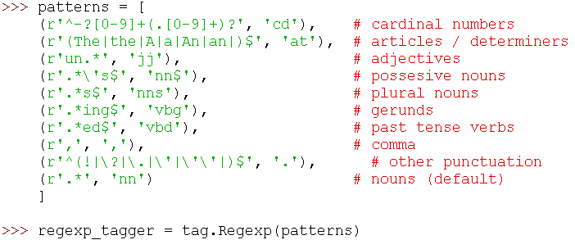
The limits of hand-encoded lexical resources
Manual construction of lexical resources is very costly
Because language keeps changing, these resources have to be continuously updated
Quantitative information (e.g., frequencies, counts) has to be computed automatically anyway
Notes:
レキシカルリソースの手動構築は非常にコストがかかる
言語は変化し続けるため、これらのリソースは継続的に更新する必要があります
とにかく定量的情報（例えば、頻度、カウント）を自動的に計算しなければならない

Slide 49
Lexical acquisition
Lexical acquisition problems
Collocations
Semantic similarity
Logical metonymy
Selectional preferences
Notes:
語彙獲得の問題
コロケーション
意味論的類似性
論理的な代名詞
選択の好み

Slide 50
Collocations
A collocation is an expression consisting of two or more words that correspond to some conventional way of saying things
Noun phrases: weapons of mass destruction, stiff breeze (but why not *stiff wind?)
Verbal phrases: to make up
Not necessarily contiguous: knock…. door
Limited compositionality
Compositional if meaning of expression can be predicted by the meaning of the parts
Idioms are most extreme examples of non-compositionality
Kick the bucket
In collocations there is an element of meaning added to the combination (i.e. the exact meaning cannot be derived directly form its components)
White hair, white wine, white woman
Notes:
コロケーションとは、従来の物事を表現する従来の方法に対応する2つ以上の単語からなる式です
名詞句：大量破壊兵器、堅い風（なぜ、強風ではない？）
言葉のフレーズ：補う
必ずしも連続している必要はありません。 ドア
限定された構成性
表現の意味がパーツの意味で予測できるならば、組成
イディオムは、非コンポジット性の最も極端な例です
バケツをキックする
コロケーションでは、組み合わせに意味の要素が追加されます（つまり、正確な意味は、その要素から直接導出できません）
白髪、白ワイン、白人女性

Slide 51
Collocations
Non Substitutability
Cannot substitute words in a collocation
*yellow wine
Non modifiability
To get a frog in one’s throat
*To get an ugly frog in one’s throat
Useful for
Language generation
*Powerful tea, *take a decision
Machine translation
Easy way to test if a combination is a collocation is to translate it into another language
Make a decision → *faire une decision (prendre), *fare una decisione (prendere)
Notes:
非置換性
コロケーションの単語を置換することはできません
*黄色いワイン
変更不可能
喉にカエルを入れるには
*喉に醜いカエルを入れるには
役に立つ
言語生成
*強力なお茶、*決定を下す
機械翻訳
組み合わせがコロケーションであるかどうかをテストする簡単な方法は、それを別の言語に翻訳することです
決定を下す→*決定を下す(フランス語) 、*決定を下す（イタリア語）

Slide 52
Finding collocations
Frequency
If two words occur together a lot, that may be evidence that they have a special function
But if we sort by frequency of pairs C(w₁, w₂), then “of the” is the most frequent pair
Filter by POS patterns
A N (linear function), N N (regression coefficients) etc..
Mean and variance of the distance of the words
For not contiguous collocations
She knocked at his door (d = 2)
A man knocked on the metal front door (d = 4)
Hypothesis testing (see page 162 Stat NLP)
How do we know it’s really a collocation?
Low mean distance can be accidental (new company)
We need to know whether two words occur together by chance or not (because they are a collocation)
Hypothesis testing
Notes:
コロケーションの検索
周波数（頻度）
2つの単語が一緒に多く出現すると、それは彼らが特別な機能を持っている証拠かもしれません
しかし、ペアC（w1、w2）の頻度でソートすると、「of」が最も頻繁にペアになります
POSパターンによるフィルタリング
A N（線形関数）、N N（回帰係数）など。
単語の距離の平均と分散
連続していないコロケーションの場合
彼女はドアをノックした（d = 2）
金属のフロントドア（d = 4）をノックした男が、
仮説検定（162ページStat NLPを参照）
私たちはそれが本当にコロケーションであることをどのように知っていますか？
低い平均距離は偶発的になる可能性がある（新規会社）
私たちは、偶然に2つの単語が一緒に出現するかどうかを知る必要があります（彼らはコロケーションなので）
仮説検定

Slide 53
Finding collocations
Mutual information measure
A measure of how much a word tells us about the other, i.e. the reduction in uncertainty of one word due to knowing about another
0 when the two words are independent
Notes:
相互情報測定
どのくらいの単語が他の単語についてどれくらいのことを伝えているか、つまり別の単語を知ることによってある単語の不確実性が減少したことの尺度
2つの単語が独立しているときは0

Slide 54
Language Models
Model to assign scores to sentences
Probabilities should broadly indicate likelihood of sentences
P( I saw a van) >> P( eyes awe of an)
Not grammaticality
P(artichokes intimidate zippers) ≈ 0
In principle, “likely” depends on the domain, context, speaker…
Adapted from Dan Klein’s CS 288 slides
Notes:
文章1つに対するスコアモデル: 単語の出現順番を用いた文章の確率を定義
文章として相当するかどうかのスコア
これは文法に準拠するものではない
減速として、『らしさ』はドメイン知識やコンテキスト、話者による。
センテンスに点数をつけるモデル
確率は文の可能性を大まかに示すべき
P( I saw a van) >> P( eyes awe of an)
文法的でない
P(アーティチョークがジッパーを威嚇する) ≒ 0
原則的に、「可能性が高い」はドメイン、文脈、話者...に依存する

Slide 55
Language Models
Model to assign scores to sentences
Sentence: w₁, w₂, … w_{n}
Break sentence probability down with chain rule (no loss of generality)
Too many histories!
Notes:
文にスコアを割り当てるモデル
文：w1、w2、... wn
チェーンルールで文章の確率を下げる（一般性を失わない）
あまりにも多くの歴史！

Slide 56
Lexical and semantic similarity
Lexical and distributional notions of meaning similarity
How can we work out how similar in meaning words are?
What is it useful for?
IR
Generalization
Semantically similar words behave similarly
QA, inference…
Notes:
意味類似性の語彙と分布の概念
意味のある言葉がどのように似ているのか
それは何のために便利ですか？
IR
一般化
意味的に類似した単語も同様に振舞う
QA、推論...
シソーラスで何かを使うことができます
メロノミー（部分表現）
例文/定義
実際には、「シソーラスベース」とは、通常、is-a / subsumption / hypernym階層を使用することを意味します
単語の類似性と単語の関連性
類似した単語はほぼ同義語です
関連性は何らかの形で関連する可能性がある
車、ガソリン：関連、似ていない
医者の看護師の熱：関連（トピック）
車、自転車：類似

Slide 57
Lexical and semantic similarity
We could use anything in the thesaurus
Meronymy
Example sentences/definitions
In practice, by “thesaurus-based” we usually just mean using the is-a/subsumption/hypernym hierarchy
Word similarity versus word relatedness
Similar words are near-synonyms
Related could be related any way
Car, gasoline: related, not similar
Doctor nurse fever: related (topic)
Car, bicycle: similar
Notes:
シソーラスにあるものは何でも使える
メロニー
例文/定義
実際には、「シソーラスベース」とは、is-a/subsumption/hypernymの階層を使用することを意味します。
単語の類似性 vs 単語の関連性
類似の単語は同義語に近い
関連はどのような形でも関連する可能性がある
車、ガソリン：関連はあるが類似はない
医者、看護婦、熱：関連（話題）
車、自転車：似ている

Slide 58
Semantic similarity
Similar if contextually interchangeable
The degree for which one word can be substituted for another in a given context
Suit similar to litigation (but only in the legal context)
Measures of similarity
WordNet-based
Vector-based
Detecting hyponymy and other relations
Notes:
コンテキスト上の互換性がある場合は同様
与えられた文脈の中である単語が他の単語に置き換えられる程度
訴訟と同様の訴訟（ただし、法的状況においてのみ）
類似性の指標
WordNetベース
ベクトルベース
hyponymyと他の関係を検出する

Slide 59
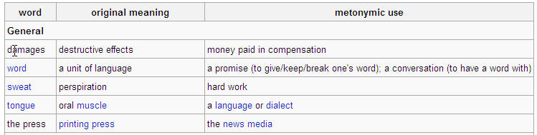
Other lexical semantics tasks
Metonymy is a figure of speech in which a thing or concept is not called by its own name, but by the name of something intimately associated with that thing or concept.
Examples:
Logical Metonymy
enjoy the book means enjoy reading the book, and easy problem means a problem that is early to solve.
Notes:
Logical metonymy: constructions in which the argument of a word in syntax appears to be different from that argument in logical form
比喩とは、ある物や概念をそれ自身の名前で呼ばず、その物や概念に密接に関連するものの名前で呼ぶという言葉の綾である。
例
論理的比喩表現
論理的メトニミー：構文上の単語の論証が、論理形式上の論証と異なって見える構文
enjoy the bookは本を読むのを楽しむ、easy problemは解くのが早い問題という意味。

Slide 60
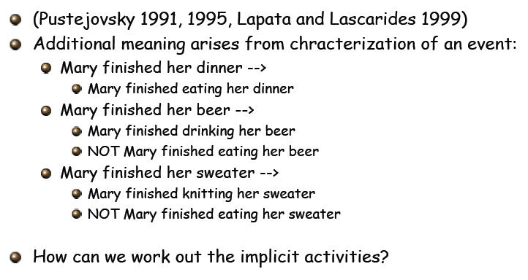
Other lexical semantics tasks
From CS 224N / Ling 280, Stanford, Manning
Notes:
Pustejovsky 1991,1995、Lapata and Lascarides 1999
追加の意味は、イベントの特徴付けから生じる。
メアリーは彼女の夕食を釣った。
メアリーはビールを飲みました→メアリーはビールを飲んだり、メアリーはビールを飲んだり
メアリーは彼女のセーターを終了しました - >メアリーは彼女のセーターを編み終わった、メアリーは彼女のセーターを食べ終わらなかった
どうやって暗黙の活動をすることができますか？

Slide 61
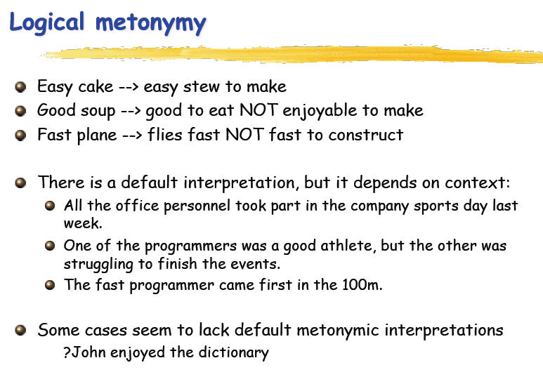
From CS 224N / Ling 280, Stanford, Manning
Notes:
簡単なケーキ - >作りやすいシチュー
良いスープ - >食べるのが楽しいではない
高速飛行機 - >飛行機は速く高速に建設する
デフォルトの解釈がありますが、文脈によって異なります。
先週の会社のスポーツデーにはすべての職員が参加した。
プログラマーの1人は良い運動選手でしたが、もう1人はイベントを終了するのに苦労していました。
速いプログラマーが100mで最初に来ました。
いくつかのケースでは、デフォルトの換喩的な（解釈が欠けているようです。
？Jhonは辞書を楽しんだ

Slide 62
Selectional preferences
Most verbs prefer arguments of a particular type: selectional preferences or restrictions
Objects of eat tend to be food, subjects of think tend to be people etc..
“Preferences” to allow for metaphors
Feat eats the soul
Why is it important for NLP?
Notes:
選択的嗜好性
ほとんどの動詞は特定のタイプの引数を好む：選択的な好みまたは制限
eatの目的語は食べ物である傾向があり、thinkの主語は人である傾向がある など。
メタファーを可能にするための "プリファレンス"
Featは魂を食べる
なぜ、それはNLPにとって重要なのか?

Slide 63
Selectional preferences
Why Important?
To infer meaning from selectional restrictions
Suppose we don’t know the words durian (not in the vocabulary)
Susan ate a very fresh durian
Infer that durian is a type of food
Ranking the possible parses of a sentence
Give higher scores to parses where the verbs has ‘natural argument”
Notes:
なぜ重要か？
選択的制約から意味を推論するため
ドリアンという単語を知らない（語彙にない）とする
スーザンはとても新鮮なドリアンを食べた
ドリアンは食べ物の一種だと推測できる
文の解析の可能性をランク付け
動詞が「自然な引数」を持つ構文に高いスコアを与える

Slide 64
Example Study: Bible Verse Search
Goal: Build a classic NLTK pipeline that turns Bible text into a searchable index
Steps: Raw text → cleaning/normalization → sentence/word tokenization → POS & lemmatization → stopword filtering → features (BoW/TF-IDF, optional LSA) → search index → query processing → ranking
Stats models in scope: n-gram LM (counts, smoothing), HMM (POS tagging)
Deliverable: Given a question/phrase, retrieve relevant verses with scores

Slide 65
Corpus & Data Layout
Corpus: Bible text (book → chapter → verse)
Granularity: Treat verse as the retrieval unit (document)
Fields: doc_id, book, chapter:verse, text
Example:
doc_id=Gen_1_1, “In the beginning God created the heaven and the earth.”
Assumption: UTF-8 text file(s) or CSV; consistent verse segmentation

Slide 66
Data Flow: What becomes What?
Input (raw):
"In the beginning God created the heaven and the earth."
Normalization:
lowercasing → "in the beginning god created the heaven and the earth."
Tokenization:
["in","the","beginning","god","created","the","heaven","and","the","earth","."]
POS tags:
[("in",IN),("the",DT),("beginning",NN),("god",NNP),...]
Lemmas:
["in","the","beginning","god","create","the","heaven","and","the","earth","."]
Filtered (no stopwords & punct):
["beginning","god","create","heaven","earth"]

Slide 67
Processing (Code Mini-Snippet)
Key operations: normalization, tokenization, sentence split
NLTK:
import nltk, re
from nltk.corpus import stopwords
from nltk.stem import WordNetLemmatizer
text = re.sub(r'\s+', ' ', text).strip().lower()
sents = nltk.sent_tokenize(text)
tokens = nltk.word_tokenize(text)
stop = set(stopwords.words('english'))
lem = WordNetLemmatizer()
tokens = [t for t in tokens if t.isalpha()]
lemmas = [lem.lemmatize(t) for t in tokens if t not in stop]
Output: clean tokens/lemmas per verse, ready for features

Slide 68
POS Tagging & Lemmatization (HMM hook)
Why POS?
better lemmatization (e.g., “saw” as noun vs. verb) & optional feature filters (nouns/verbs only)
NLTK: nltk.pos_tag(tokens)
HMM Tagger (concept):
sequence model over POS tags → improves tagging via context
Example:
“light shines in darkness” → POS sequence influences lemma: “shines” → “shine”

Slide 69
Feature Extraction: BoW / TF-IDF
BoW: term counts per verse → Document–Term Matrix (DTM)
TF-IDF: downweight corpus-common terms, highlight discriminative words
Cosine similarity: basis of ranking for verse retrieval
sklearn:
from sklearn.feature_extraction.text import TfidfVectorizer
vect = TfidfVectorizer(tokenizer=lambda s: s, preprocessor=lambda x: x, lowercase=False)
X = vect.fit_transform(lemmas_per_doc) # list[list[str]] or join to space
Output: sparse TF-IDF matrix X, vocabulary vect.vocabulary_

Slide 70
(Optional) LSA for Semantic Smoothing
Index: keep doc_id → vector (TF-IDF or LSA)
Metadata: book, chapter:verse, original text for display
Query pipeline: apply the same preprocessing (normalize → tokenize → POS → lemma → vectorize)
Ranking: cosine similarity between query vector and verse vectors

Slide 71
Query Processing (Example)
Query: “creation of heaven and earth”
After pipeline: ["creation","heaven","earth"] → TF-IDF/LSA vector
Top-k results:
Gen 1:1 — In the beginning God created … the heaven and the earth.
Gen 2:1 — Thus the heavens and the earth were finished …
UI idea: highlight matched terms; show score & reference

Slide 72
n-gram Counts (Code Mini-Snippet)
NLTK:
from nltk import ngrams
from collections import Counter
bigrams = Counter(ngrams(all_tokens, 2))
unigrams = Counter(all_tokens)
def p_ml(w2, w1): # MLE bigram
return (bigrams[(w1,w2)] + 1) / (unigrams[w1] + len(unigrams)) # Laplace
Demo: compute top continuations for ("in","the") → beginning, house, name…

Slide 73
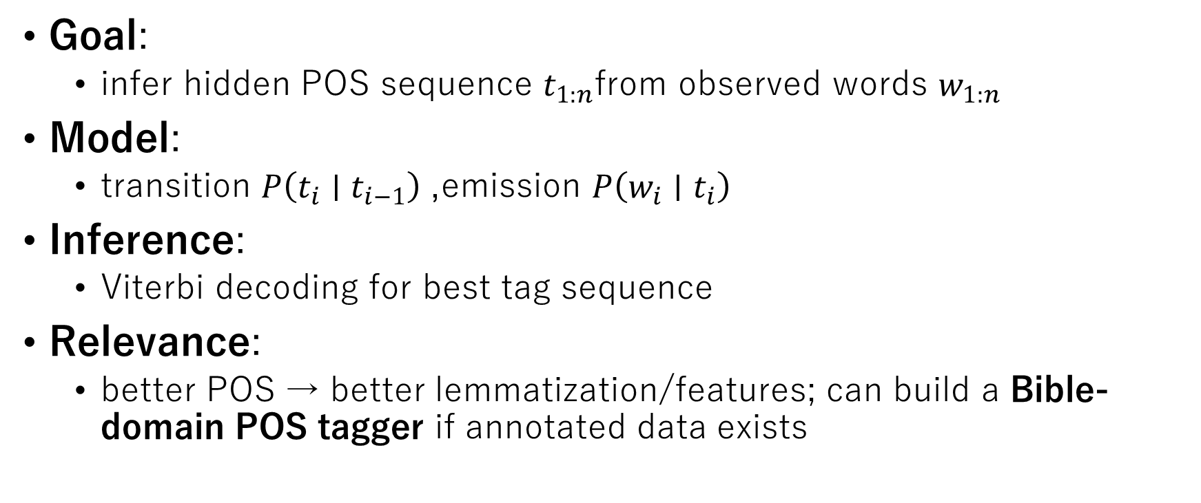
HMM for POS Tagging (Concepts)
Goal:
infer hidden POS sequence $t_{1:n}$from observed words $w_{1:n}$
Model:
transition $P\left(t_{i}∣t_{i−1}\right)$, emission $P\left(w_{i}∣t_{i}\right)$
Inference:
Viterbi decoding for best tag sequence
Relevance:
better POS → better lemmatization/features; can build a Bible-domain POS tagger if annotated data exists

Slide 74
HMM Tagger (NLTK Demo)
NLTK (if available in your environment):
from nltk.tag.hmm import HiddenMarkovModelTagger
# train on a tagged corpus (e.g., treebank tagged_sents)
hmm = HiddenMarkovModelTagger.train(tagged_sents)
hmm.tag(["in","the","beginning","god","created"])
Note: If no domain tags, fall back to pos_tag (Perceptron) and explain pros/cons

Slide 75
Putting it together: Evaluation and next steps
Sanity checks:
sample queries return expected verses; qualitative inspection
Quantitative
(if you have labeled queries): Precision@k, Recall@k, nDCG
Ablations:
BoW vs TF-IDF vs LSA；with/without lemmatization；with/without stopwords

Slide 76
Conclusion - Key Takeaways from Lec. 1
1. What NLP Is and Why It Matters
NLP converts human language into computable representations for understanding, generation, and interaction.
Core tasks include tokenization, POS tagging, syntactic/semantic analysis, and task-specific reasoning.
Applications range from information retrieval and question answering to translation and summarization.
2. Fundamental Concepts Covered Today
NLP definitions, goals, and historical paradigm shifts.
Three understanding pipelines: classical linguistics-based, brain/cognitive, and modern neural (DNN).
Core feature representations: Bag-of-Words, TF-IDF, and Latent Semantic Analysis, illustrated with NLTK Bible search.
3. Roadmap to the Next Lectures
Hands-on Exercise 1 (10/8) – Self study!
From symbolic and statistical methods (n-gram, Markov, HMM) toward neural sequence models (RNN, LSTM).
Upcoming lectures will deepen the journey into statistical language modeling and recurrent neural architectures.

